Slide 1
Faltende neuronale netze
Eine Präsentation von Benjamin Jank

Slide 2
Übersicht über Maschinelles Lernen
Künstliche Intelligenz
„ist ein Teilgebiet der Informatik. Sie imitiert menschliche kognitive Fähigkeiten [...]. Diese Intelligenz kann auf programmierten Abläufen basieren oder durch maschinelles Lernen erzeugt werde.“ (Frauenhofer-Institut für Kognitive Systeme IKS)
Maschinelles Lernen
„ist ein Teilbereich der künstlichen Intelligenz (KI). Der Schwerpunkt liegt auf dem Trainieren von Computern, damit diese aus Daten und Erfahrungen lernen […] – anstatt explizit dafür programmiert zu werden.“ (SAP)
Algorithmen
Maschinelles Lernen

Slide 3
Übersicht über Maschinelles Lernen
Algorithmen
Maschinelles Lernen
Input
Input
f(x)
Zustand
f(x)
Output
Output

Slide 4
Übersicht über Maschinelles Lernen
Maschinelles Lernen
Überwachtes
Lernen
Unüberwachtes
Lernen
Bestärkendes
Lernen
Klassifizierung
Regression

Slide 5
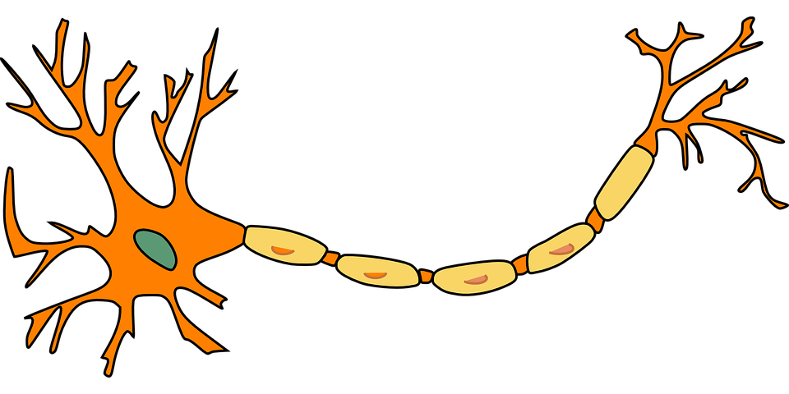
Funktionsweise faltender neuronaler Netze

Slide 6
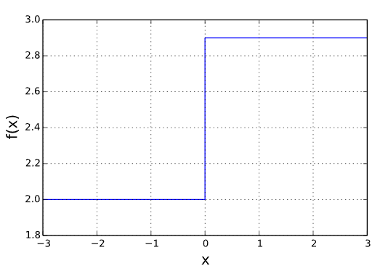
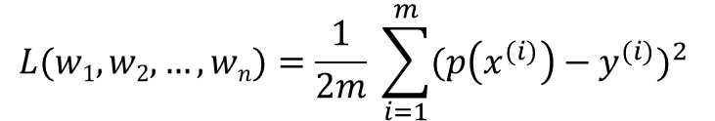
Das Single Layer Perceptron
p(x)
Die Fehlerfunktion
Parameter von Model als Eingabe
Gibt Abweichung des Models von Wahrheitswerten zurück
Mean Squared Error Funktion:
w₁
z = X₁*w₁ + X₂*w₂ + … + X_{n}*w_{n}
Y = f(z)
X₁
w₂
X₂
Y
…
$$L(w1, w2, …, wn)=\frac{1}{2m} \sum_{i=1}^{m}{{(p\left(x^{(i)}\right)−y^{(i)})}^{2} }$$
w_{n}
X_{n}

Slide 7
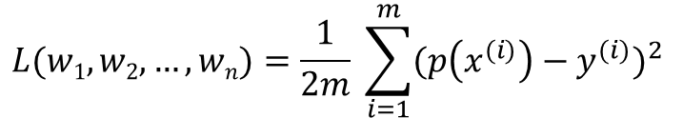
Das Single Layer Perceptron
p(x)
$$L(w1, w2, …, wn)=\frac{1}{2m} \sum_{i=1}^{m}{{(p\left(x^{(i)}\right)−y^{(i)})}^{2} }$$
w₁
z = X₁*w₁ + X₂*w₂ + … + X_{n}*w_{n}
Y = f(z)
Das Gradientenverfahren
Iterativer Algorithmus, um differenzierbare Funktion zu minimieren
Hilfsmittel, um Fehlerfunktion zu optimieren
X₁
w₂
X₂
Y
…
w_{n}
X_{n}

Slide 8
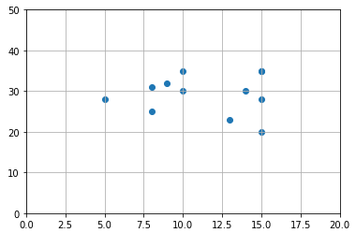
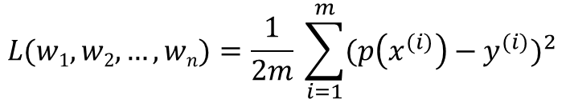
Das Single Layer Perceptron
p(x)
$$L(w1, w2, …, wn)=\frac{1}{2m} \sum_{i=1}^{m}{{(p\left(x^{(i)}\right)−y^{(i)})}^{2} }$$
w₁
z = X₁*w₁ + X₂*w₂ + … + X_{n}*w_{n}
Y = z
Das Gradientenverfahren
Iterativer Algorithmus, um differenzierbare Funktion zu minimieren
Hilfsmittel, um Fehlerfunktion zu optimieren
X₁
w₂
X₂
Y
…
w_{n}
X_{n}

Slide 9
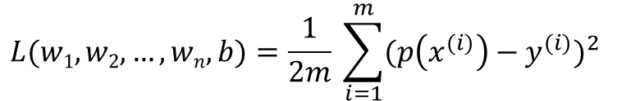
Das Single Layer Perceptron
p(x)
$$L(w1, w2, …, wn,b)=\frac{1}{2m} \sum_{i=1}^{m}{{(p\left(x^{(i)}\right)−y^{(i)})}^{2} }$$
w₁
z = X₁*w₁ + X₂*w₂ + … + X_{n}*w_{n} + b
Y = z
Das Gradientenverfahren
Iterativer Algorithmus, um differenzierbare Funktion zu minimieren
Hilfsmittel, um Fehlerfunktion zu optimieren
X₁
w₂
X₂
Y
…
w_{n}
X_{n}
b

Slide 10
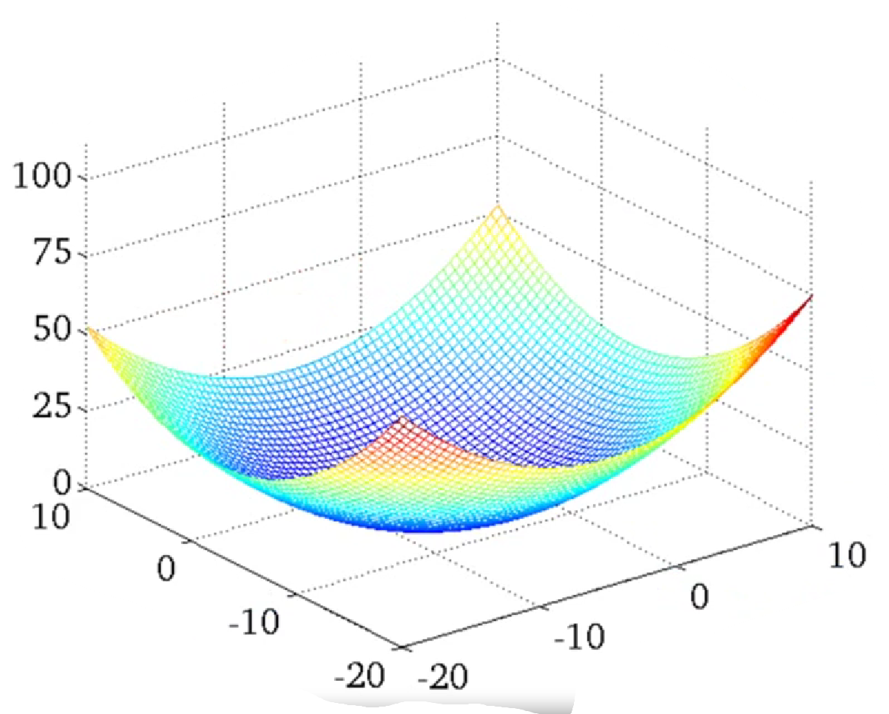
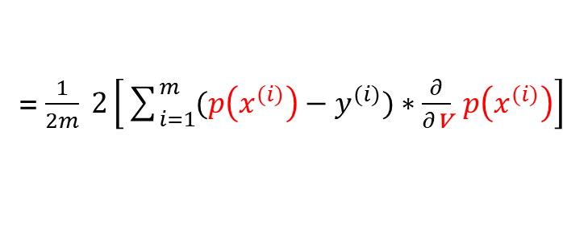
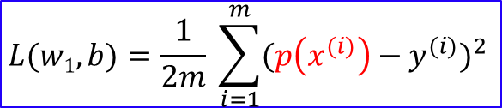
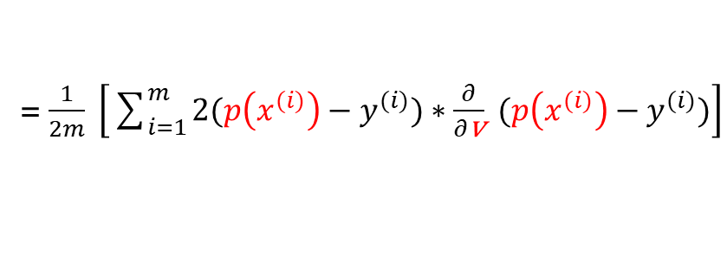

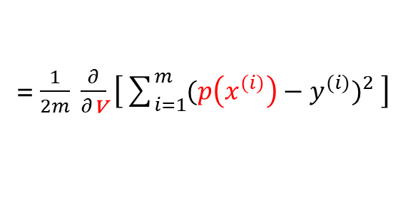


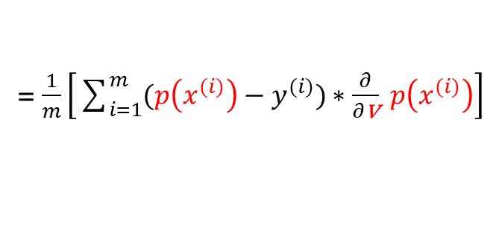
Das Gradientenverfahren
$$\text{w}\text{1} ≔\text{w}\text{1}−α∗\frac{∂\text{L}}{∂\text{w}\text{1}} \\ b≔b−α∗\frac{∂\text{L}}{∂\text{b}}$$
$$L(w1, b)=\frac{1}{2m} \sum_{i=1}^{m}{{(p\left(x^{(i)}\right)−y^{(i)})}^{2} }$$
$\frac{∂\text{L}}{∂\text{v}}$ = $\frac{∂}{∂\text{v}}$ $\left[\frac{1}{2m}\sum_{i=1}^{m}{{(p\left(x^{(i)}\right)−y^{(i)})}^{2} }\right]$
x P
= $\frac{1}{2m} \frac{∂}{∂\text{v}}$ $\left[\sum_{i=1}^{m}{{(p\left(x^{(i)}\right)−y^{(i)})}^{2} }\right]$
L
= $\frac{1}{2m} \left[\sum_{i=1}^{m}{{\frac{∂}{∂\text{v}} (p\left(x^{(i)}\right)−y^{(i)})}^{2} }\right]$
= $\frac{1}{2m} \left[\sum_{i=1}^{m}{2(p\left(x^{(i)}\right)−y^{(i)})}∗\frac{∂}{∂\text{v}} (p\left(x^{(i)}\right)−y^{(i)})\right]$
= $\frac{1}{2m} 2\left[\sum_{i=1}^{m}{(p\left(x^{(i)}\right)−y^{(i)})}∗\frac{∂}{∂\text{v}} p\left(x^{(i)}\right)\right]$
= $\frac{1}{m}\left[\sum_{i=1}^{m}{(p\left(x^{(i)}\right)−y^{(i)})}∗\frac{∂}{∂\text{v}} p\left(x^{(i)}\right)\right]$
w₁
b

Slide 11
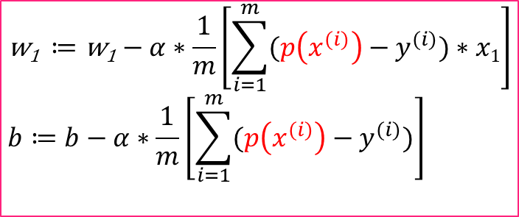

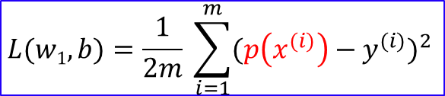



Das Gradientenverfahren
$$L(w1, b)=\frac{1}{2m} \sum_{i=1}^{m}{{(p\left(x^{(i)}\right)−y^{(i)})}^{2} }$$
$\frac{∂\text{L}}{∂\text{v}}$ = $\frac{1}{m}\left[\sum_{i=1}^{m}{(p\left(x^{(i)}\right)−y^{(i)})}∗\frac{∂}{∂\text{v}} p\left(x^{(i)}\right)\right]$
$p\left(x^{(i)}\right)$ = ${x1}^{(i)}∗w1+b$
x P
x P
$⇒\frac{∂\text{L}}{∂\text{w}\text{1}}$ = $\frac{1}{m}\left[\sum_{i=1}^{m}{(p\left(x^{(i)}\right)−y^{(i)})}∗x1\right]$
L
$⇒\frac{∂\text{L}}{∂\text{b}}$ = $\frac{1}{m}\left[\sum_{i=1}^{m}{(p\left(x^{(i)}\right)−y^{(i)})}\right]$
$$\text{w}\text{1} ≔\text{w}\text{1}−α∗\frac{1}{m}\left[\sum_{i=1}^{m}{(p\left(x^{(i)}\right)−y^{(i)})}∗x1\right] \\ b≔b−α∗\frac{1}{m}\left[\sum_{i=1}^{m}{(p\left(x^{(i)}\right)−y^{(i)})}\right]$$
w₁
b

Slide 12
Das Single Layer Perceptron
p(x)
w₁
z = X₁*w₁ + X₂*w₂ + … + X_{n}*w_{n} + b
Y = z
X₁
w₂
X₂
Y
…
w_{n}
X_{n}
b
1

Slide 13
Das Single Layer Perceptron
p(x)
w₁
z = X₁*w₁ + X₂*w₂ + … + X_{n}*w_{n} + b
Y = f(z)
X₁
w₂
X₂
Y
…
w_{n}
X_{n}
b
1

Slide 14
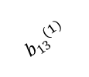
















Das Multilayer Perceptron
z₁⁽²⁾ a₁⁽²⁾
$${w22}^{(2)}$$
$${w11}^{(1)}$$
$${w32}^{(2)}$$
x₁
$${w21}^{(1)}$$
z₁⁽³⁾ a₁⁽³⁾
$${w31}^{(1)}$$
$${w22}^{(2)}$$
$${w12}^{(1)}$$
z₂⁽²⁾ a₂⁽²⁾
$${w32}^{(2)}$$
$${w22}^{(1)}$$
x₂
$${w32}^{(1)}$$
z₂⁽³⁾ a₂⁽³⁾
$${w22}^{(2)}$$
$${b13}^{(1)}$$
$${w32}^{(2)}$$
$${b23}^{(1)}$$
z₃⁽²⁾ a₃⁽²⁾
₁
$${b33}^{(1)}$$
$${b11}^{(2)}$$
$${b21}^{(2)}$$
₁
L1
L2
L3

Slide 15

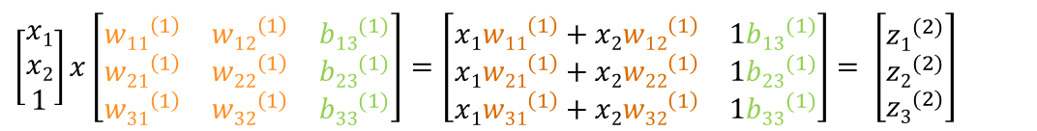

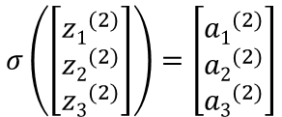

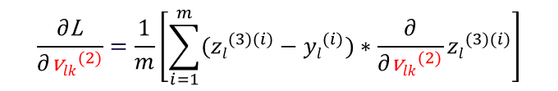
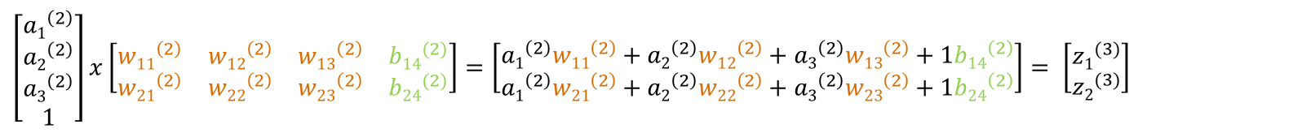
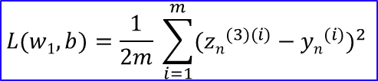
Das Multilayer Perceptron
$\left[\begin{matrix}x1 \\ x2 \\ 1\end{matrix}\right]x\left[\begin{matrix}{w11}^{\left(1\right)} & {w12}^{\left(1\right)} & {b13}^{(1)} \\ {w21}^{\left(1\right)} & {w22}^{\left(1\right)} & {b23}^{(1)} \\ {w31}^{\left(1\right)} & {w32}^{\left(1\right)} & {b33}^{(1)}\end{matrix}\right]$ $=\left[\begin{matrix}x1{w11}^{\left(1\right)}+x2{w12}^{\left(1\right)} & 1{b13}^{(1)} \\ x1{w21}^{\left(1\right)}+x2{w22}^{\left(1\right)} & 1{b23}^{(1)} \\ x1{w31}^{\left(1\right)}+x2{w32}^{\left(1\right)} & 1{b33}^{(1)}\end{matrix}\right]$ $= \left[\begin{matrix}{z1}^{(2)} \\ {z2}^{(2)} \\ {z3}^{(2)}\end{matrix}\right]$
$$σ\left(\left[\begin{matrix}{z1}^{(2)} \\ {z2}^{(2)} \\ {z3}^{(2)}\end{matrix}\right]\right)=\left[\begin{matrix}{a1}^{(2)} \\ {a2}^{(2)} \\ {a3}^{(2)}\end{matrix}\right]$$
$\left[\begin{matrix}{a1}^{\left(2\right)} \\ {a2}^{\left(2\right)} \\ {a3}^{\left(2\right)} \\ 1\end{matrix}\right]x\left[\begin{matrix}{w11}^{\left(2\right)} & {w12}^{\left(2\right)} & {w13}^{\left(2\right)} & {b14}^{(2)} \\ {w21}^{\left(2\right)} & {w22}^{\left(2\right)} & {w23}^{\left(2\right)} & {b24}^{(2)}\end{matrix}\right]=\left[\begin{matrix}{a1}^{\left(2\right)}{w11}^{\left(2\right)}+{a2}^{\left(2\right)}{w12}^{\left(2\right)}+{a3}^{\left(2\right)}{w13}^{\left(2\right)}+1{b14}^{\left(2\right)} \\ {a1}^{\left(2\right)}{w21}^{\left(2\right)}+{a2}^{\left(2\right)}{w22}^{\left(2\right)}+{a3}^{\left(2\right)}{w23}^{\left(2\right)}+1{b24}^{\left(2\right)}\end{matrix}\right]$ $= \left[\begin{matrix}{z1}^{(3)} \\ {z2}^{(3)}\end{matrix}\right]$
$$f\left(\left[\begin{matrix}{z1}^{(3)} \\ {z2}^{(3)}\end{matrix}\right]\right)=\left[\begin{matrix}{a1}^{(3)} \\ {a2}^{(3)}\end{matrix}\right]$$
$$L(w1, b)=\frac{1}{2m} \sum_{i=1}^{m}{{({zn}^{(3)(i)}−{yn}^{(i)})}^{2} }$$
$$\frac{∂\text{L}}{∂{\text{v}lk}^{(2)}}=\frac{1}{m}\left[\sum_{i=1}^{m}{({zl}^{(3)(i)}−{yl}^{(i)})}∗\frac{∂}{∂{\text{v}lk}^{(2)}}{zl}^{(3)(i)}\right]$$
$\frac{∂{zl}^{(3)(i)}}{∂{\text{v}lk}^{(2)}}=$ $\frac{∂}{∂{\text{v}lk}^{(2)}} \left({a1}^{\left(2\right)}{wl1}^{\left(2\right)}+{a2}^{\left(2\right)}{wl2}^{\left(2\right)}+{a3}^{\left(2\right)}{wl3}^{\left(2\right)}+1{bl4}^{\left(2\right)}\right)$
$⇒\frac{∂\text{L}}{∂{wlk}^{\left(2\right)}}$ = $\frac{1}{m}\left[\sum_{i=1}^{m}{({zl}^{(3)(i)}−{yl}^{(i)}}∗{ak}^{\left(2\right)}\right]$
$⇒\frac{∂\text{L}}{∂{bl4}^{\left(2\right)}}$ = $\frac{1}{m}\left[\sum_{i=1}^{m}{({zl}^{(3)(i)}−{yl}^{(i)})}\right]$

Slide 16

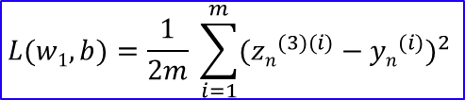
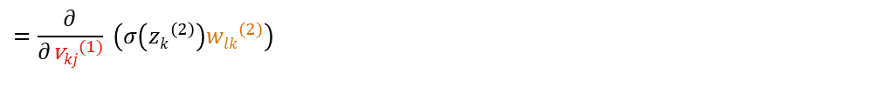
Das Multilayer Perceptron
$\left[\begin{matrix}x1 \\ x2 \\ 1\end{matrix}\right]x\left[\begin{matrix}{w11}^{\left(1\right)} & {w12}^{\left(1\right)} & {b13}^{(1)} \\ {w21}^{\left(1\right)} & {w22}^{\left(1\right)} & {b23}^{(1)} \\ {w31}^{\left(1\right)} & {w32}^{\left(1\right)} & {b33}^{(1)}\end{matrix}\right]$ $=\left[\begin{matrix}x1{w11}^{\left(1\right)}+x2{w12}^{\left(1\right)} & 1{b13}^{(1)} \\ x1{w21}^{\left(1\right)}+x2{w22}^{\left(1\right)} & 1{b23}^{(1)} \\ x1{w31}^{\left(1\right)}+x2{w32}^{\left(1\right)} & 1{b33}^{(1)}\end{matrix}\right]$ $= \left[\begin{matrix}{z1}^{(2)} \\ {z2}^{(2)} \\ {z3}^{(2)}\end{matrix}\right]$
$$σ\left(\left[\begin{matrix}{z1}^{(2)} \\ {z2}^{(2)} \\ {z3}^{(2)}\end{matrix}\right]\right)=\left[\begin{matrix}{a1}^{(2)} \\ {a2}^{(2)} \\ {a3}^{(2)}\end{matrix}\right]$$
$\left[\begin{matrix}{a1}^{\left(2\right)} \\ {a2}^{\left(2\right)} \\ {a3}^{\left(2\right)} \\ 1\end{matrix}\right]x\left[\begin{matrix}{w11}^{\left(2\right)} & {w12}^{\left(2\right)} & {w13}^{\left(2\right)} & {b14}^{(2)} \\ {w21}^{\left(2\right)} & {w22}^{\left(2\right)} & {w23}^{\left(2\right)} & {b24}^{(2)}\end{matrix}\right]=\left[\begin{matrix}{a1}^{\left(2\right)}{w11}^{\left(2\right)}+{a2}^{\left(2\right)}{w12}^{\left(2\right)}+{a3}^{\left(2\right)}{w13}^{\left(2\right)}+1{b14}^{\left(2\right)} \\ {a1}^{\left(2\right)}{w21}^{\left(2\right)}+{a2}^{\left(2\right)}{w22}^{\left(2\right)}+{a3}^{\left(2\right)}{w23}^{\left(2\right)}+1{b24}^{\left(2\right)}\end{matrix}\right]$ $= \left[\begin{matrix}{z1}^{(3)} \\ {z2}^{(3)}\end{matrix}\right]$
$$f\left(\left[\begin{matrix}{z1}^{(3)} \\ {z2}^{(3)}\end{matrix}\right]\right)=\left[\begin{matrix}{a1}^{(3)} \\ {a2}^{(3)}\end{matrix}\right]$$
$$L(w1, b)=\frac{1}{2m} \sum_{i=1}^{m}{{({zn}^{(3)(i)}−{yn}^{(i)})}^{2} }$$
$=$ ${wlk}^{\left(2\right)}∗\frac{∂{zk}^{\left(2\right)}}{∂{\text{v}kj}^{\left(1\right)}}σ\left({zk}^{\left(2\right)}\right)∗\frac{∂{zk}^{\left(2\right)}}{∂{\text{v}kj}^{\left(1\right)}}{zk}^{\left(2\right)}$
$$\frac{∂\text{L}}{∂{\text{v}kj}^{(1)}}=\frac{1}{m}\left[\sum_{i=1}^{m}{({zl}^{(3)(i)}−{yl}^{(i)})}∗\frac{∂}{∂{\text{v}kj}^{(1)}}{zl}^{(3)(i)}\right]$$
$\frac{∂{zl}^{(3)(i)}}{∂{\text{v}kj}^{(1)}}=$ $\frac{∂}{∂{\text{v}kj}^{(1)}} \left({a1}^{\left(2\right)}{wl1}^{\left(2\right)}+{a2}^{\left(2\right)}{wl2}^{\left(2\right)}+{a3}^{\left(2\right)}{wl3}^{\left(2\right)}+1{bl4}^{\left(2\right)}\right)$
$=$ $\frac{∂}{∂{\text{v}kj}^{(1)}} \left({ak}^{\left(2\right)}{wlk}^{\left(2\right)}\right)=\frac{∂}{∂{\text{v}kj}^{(1)}} \left(σ\left({zk}^{\left(2\right)}\right){wlk}^{\left(2\right)}\right)$
$$=\frac{∂}{∂{\text{v}kj}^{(1)}} \left(σ\left({zk}^{\left(2\right)}\right){wlk}^{\left(2\right)}\right)$$
$$=\frac{∂σ\left({zk}^{\left(2\right)}\right)}{∂{\text{v}kj}^{(1)}} \left(σ\left({zk}^{\left(2\right)}\right){wlk}^{\left(2\right)}\right)∗\frac{∂}{∂{\text{v}kj}^{(1)}}σ\left({zk}^{\left(2\right)}\right)$$

